Slide 1
EDA REPORT FOR CUSTOMER CHURNING
Jahnavi Rambha
AWDCRJY
2ND Year

Slide 2
Overview
1
You have to use EDA to analyze the customer who are churned
We will Perform this Exploratory Data Analysis in order to get actionable insights, and convert them into meaningful stories and present it so that the companies can take necessary actions in order to retain their customers

Slide 3
PROBLEM STATEMENT
2
Conduct a thorough Exploratory Data Analysis on the bank customer dataset to reveal key characteristics, trends, and potential factors influencing customer churn. Identify and visualize patterns in customer behavior, demographics, and interactions with the bank's services. Additionally, highlight any anomalies, missing values, or outliers that may impact the quality of the dataset. The insights derived from EDA will guide feature selection, preprocessing steps, and model development for predicting customer churn effectively.

Slide 4
UNDERSTANDING THE DATA
3

Slide 5
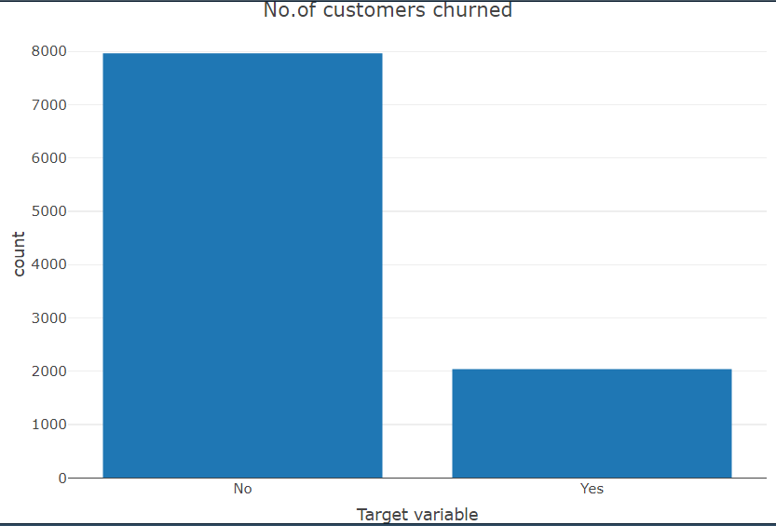
TARGET VARIABLE
Findings
Data is almost in balanced , The ratio is almost 80:20
20 percent of customers were churned
We need to analyze the data with other features while taking the target values separately to get some insights

Slide 6
MISSING DATA
5
FINDINGS
Two columns have a missing data and of it has 3% of missing values and another has 5% of missing values and remaining columns doesn’t have missing data .
For features with less missing values can use regression to predict the missing values or fill it with the mean of the values present and depending on the feature
For Features with very high number of missing values – it is better to drop those columns as they give very less insight on analysis.
As there is no thumb rule on what criteria do we delete the columns with missing values ,we have done a small analysis and have taken decisions , analysis is to be continued in next slides

Slide 7
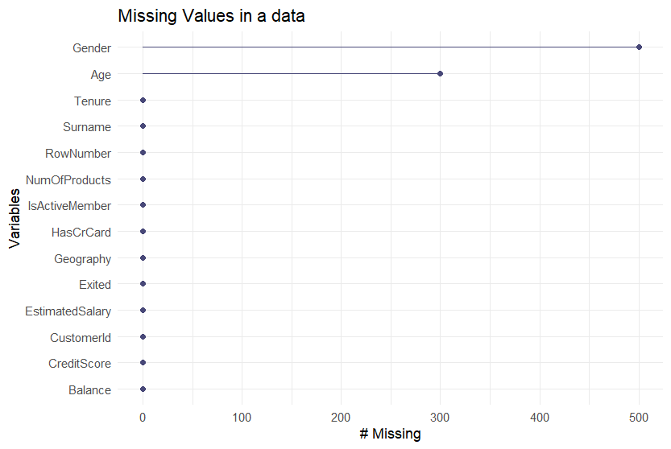
INITIAL INTUITION FROM THE DATA
6
FINDINGS
Total columns have more than 5% of missing values , in number we have 800 null values
As there is no thumb rule to drop the variables having more than 30% null values , as scenarios might vary from case to case , and the amount of information we think the variable has.
However we kept these columns : Age and Gender and have analyzed further , as these columns seems to carry some important information and two of them are connected with churning that which age group were most churned and which gender has churned more might have an impact on the analysis
So ,We filled age column with their median values and Gender column with mode as it is categorical column

Slide 8
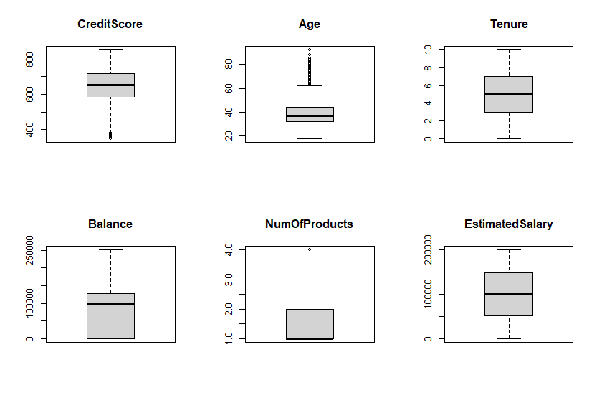
OUTLIERS ANALYSIS
Here we can notice extreme values present in numerical columns like Credit Score , Age and Num Of Products.
We consider these values as outliers which means that observations that lies an abnormal distance from other values.
These outliers can be removed or replaced based on the necessity
But here these outliers are not effecting our analysis . So we just ignored them

Slide 9
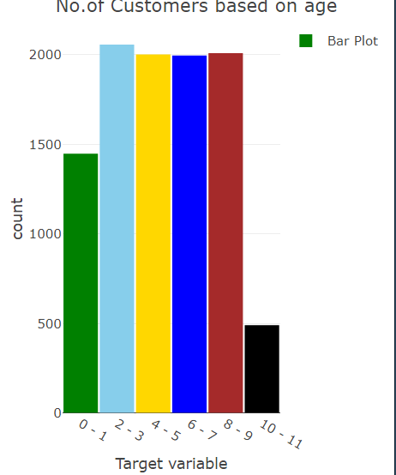
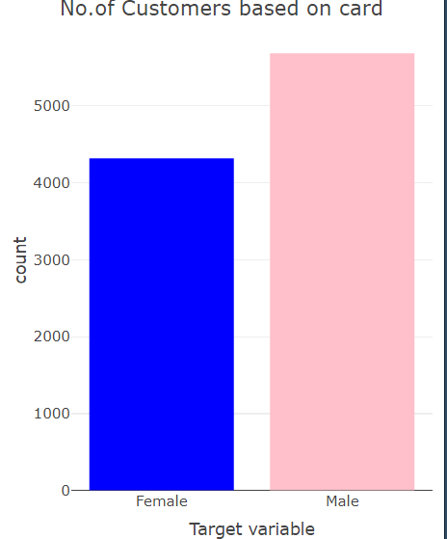
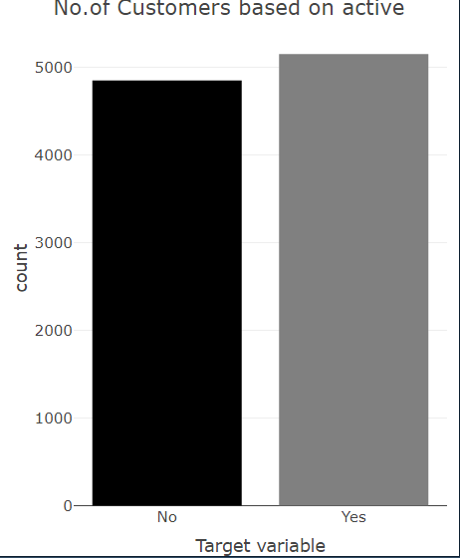
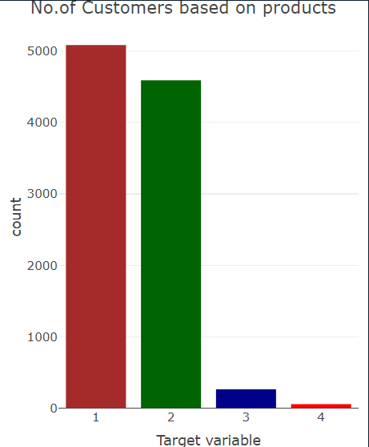
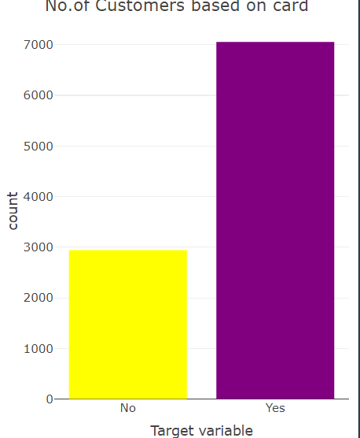
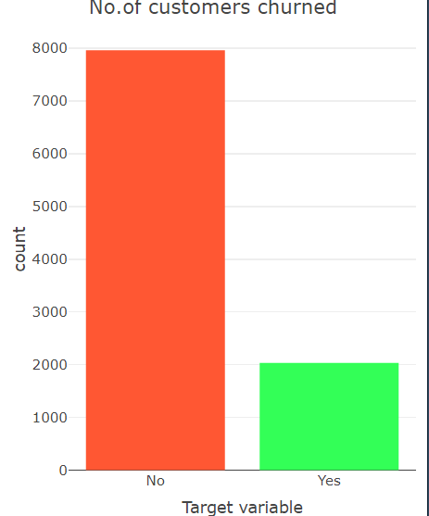
UNIVARIATE ANALYSIS
FINDINGS
By just analyzing single variables , we won’t find much insights related to the churned customers , as here we will just have an idea which category of people are present in abundance , other than that , most of the insights are gathered in analysis of multiple variables with our target variable

Slide 10
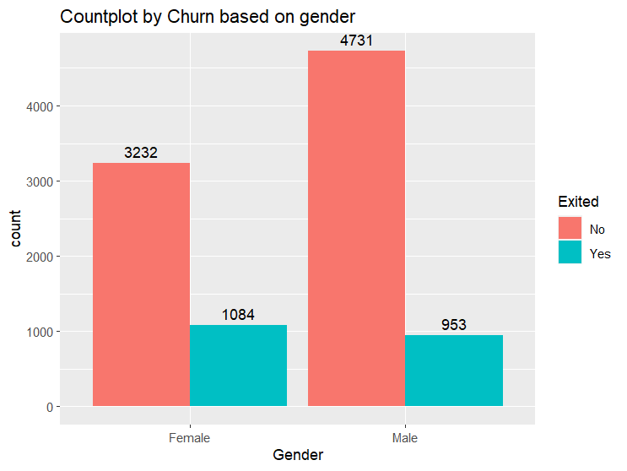
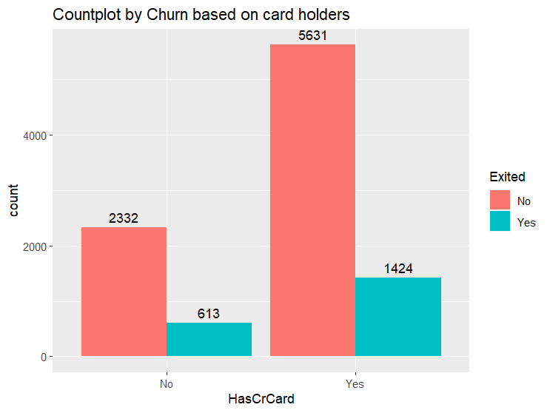
GENDER VS TARGET VARIABLE
CARD HOLDERS VS TARGET VARIABLE
INSIGHT
The data revealing a higher churn rate among females (25%) compared to males (16%) suggests potential gender-specific patterns in customer behavior within a given context.
INSIGHT
The revelation that both customers with cards and those without cards exhibit the same churn rate of 20% suggests that card ownership, at least in the context provided, may not be a decisive factor influencing customer retention.
while the card ownership status does not appear to be a differentiating factor in customer churn, it underscores the importance of examining broader market dynamics and common challenges that impact all customers.

Slide 11
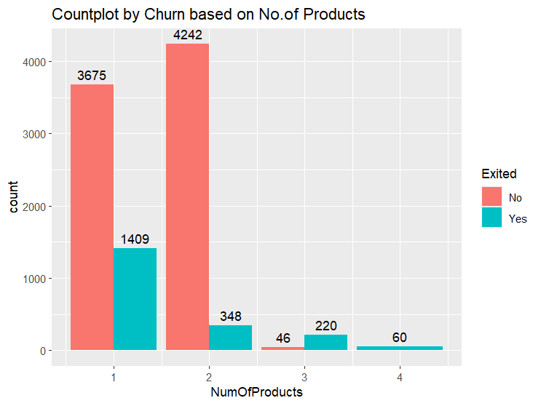
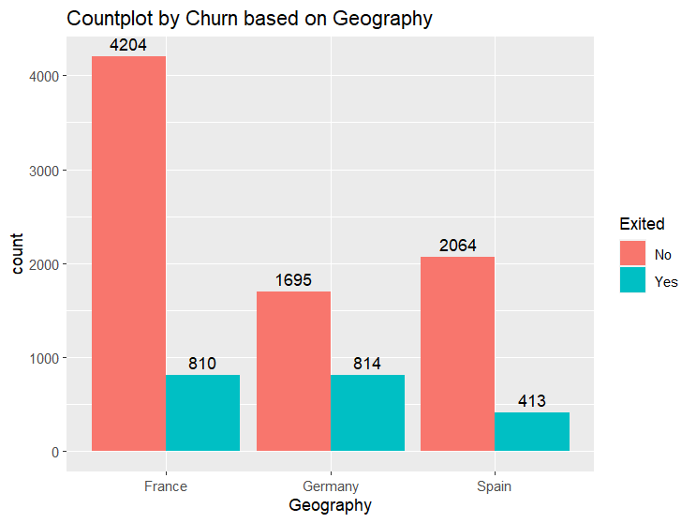
PRODUCTS VS TARGET VARIABLE
GEOGRAPHY VS TARGET VARIABLE
INSIGHT
From the above graph we get insights that customers with one product have 28% and two products have 7% and three products have 82% and four products have 100% of churn rate.
An unexpected insight is that Customers with more products are more likely two churn.
INSIGHT
The varying churn rates between France (16%) and Spain (16%) compared to Germany (32%) suggest interesting dynamics that may be influenced by diverse factors
. We cans see high churn rate recorded in Germany when compared to France and Spain
And surprisingly both France and Spain has same churn rate

Slide 12
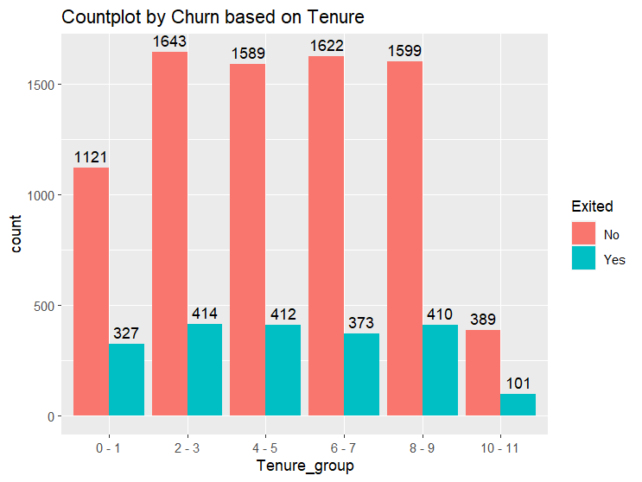
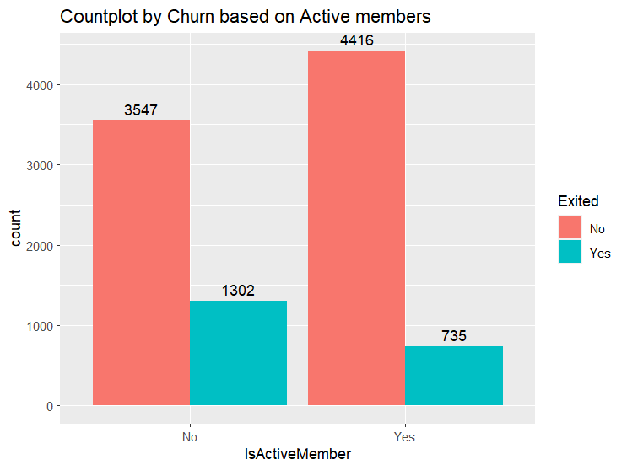
TENURE VS TARGET VARIABLE
ACTIVE STATUS VS TARGET VARIABLE
INSIGHT
The observation that all months have an equal churn rate except for the 6th and 7th months suggests a specific pattern in customer behavior during these timeframes
INSIGHT
The above graph shows the churning of customers w ho are active and not active
We got a insight that was expected is customers who are less active are churning about 26%
But there is an unexpected aspect that even active members are churning with 14% .

Slide 13
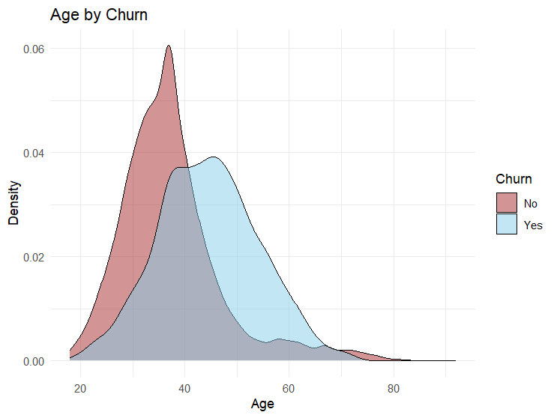
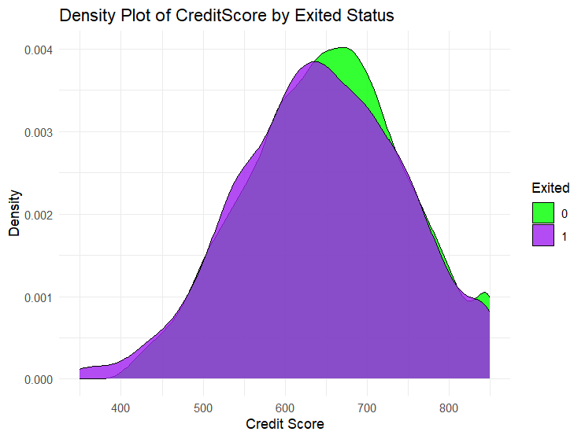
AGE VS TARGET VARIABLE
CREDIT SCORE VS TARGET VARIABLE
INSIGHT
The surprising insight we got is that customers with age 30 to 40 are not willing to churn
The customers with age between 40-50 are more likely to churn
And the customers between 70-80 are having 50-50 chances of churning rate
INSIGHT
Customers having credit score above 600 and below 700 are churning
Customers having credit score above 700a and below are not willing to churn
One more insight is that customers with credit score above 800 are less likely to churn

Slide 14
BIVARIATE ANALYSIS
13
As we didn’t get a correct insights from geography and card holders let us start bivariate analysis with respect to gender as we are having clear insights on gender

Slide 15
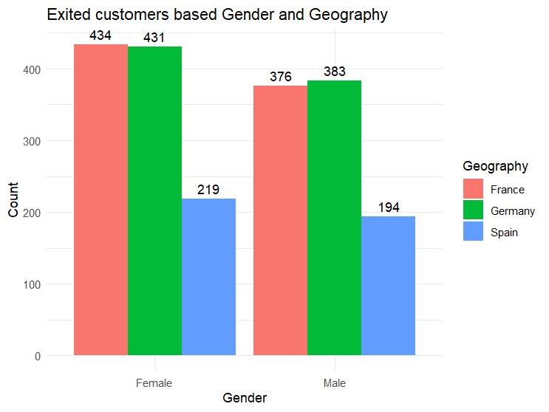
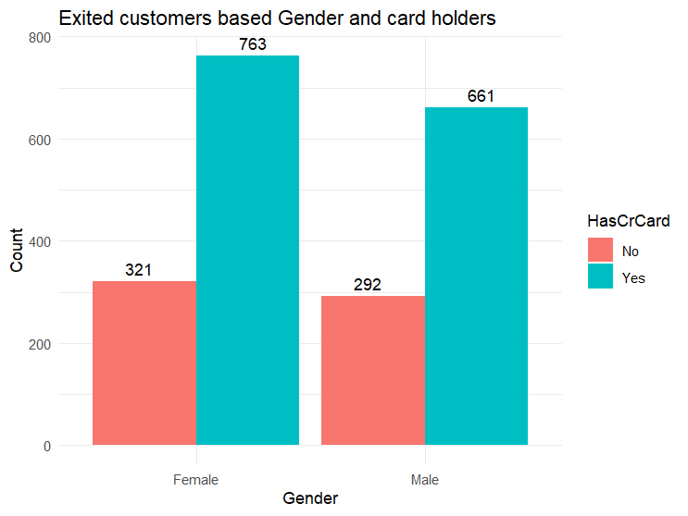
CHURNING BASED ON GENDER AND GEOGRAPHY
CHURNING BASED ON GENDER AND CARD HOLDERS
INSIGHT
In Univariate analysis we got to know that Spain and France are having same churn rate . So now let us make Bivariate analysis with gender so that we will get to know
This was an surprising insight that both male and female of Spain are less in percentage to churn
And Both male and female are more likely to churn from Germany and France
By this customers of Germany has high chances to churn based on univariate and bivariate analysis
INSIGHT
In Uni variate Analysis we got no insight from the card holders . Now with the help of Bi variate Analysis we may get insight
From our data we got an unforseen insight that is both and female customers who are card holders are more likely to churn

Slide 16
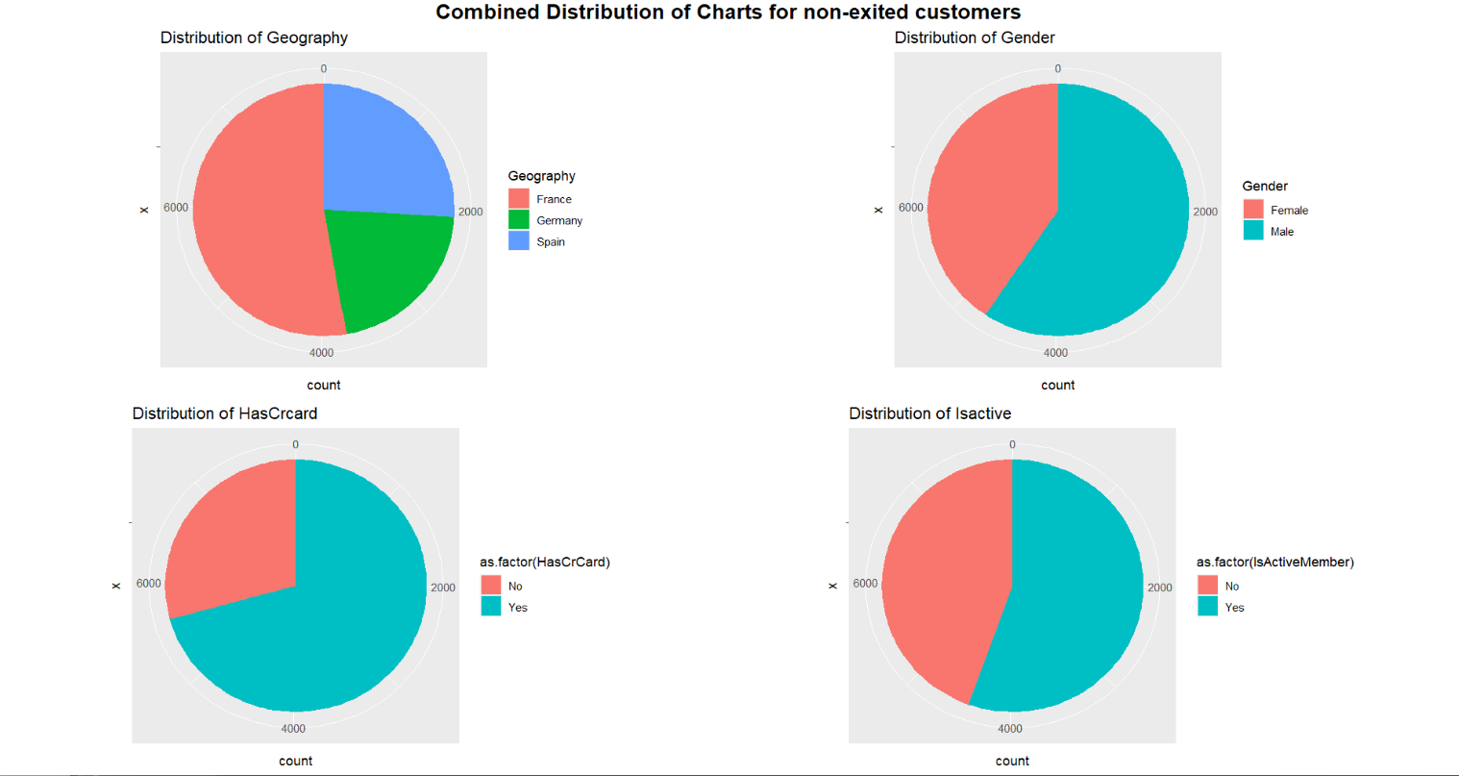
NOT EXITED CUSTOMERS PLOTS

Slide 17
NUMERICAL ANALYSIS
NUMERICAL ANALYSIS I.E TO FIND CORRELATION BETWEEN THE VARIABLES WILL HELP US IN FURTHER ANALYSIS

Slide 18
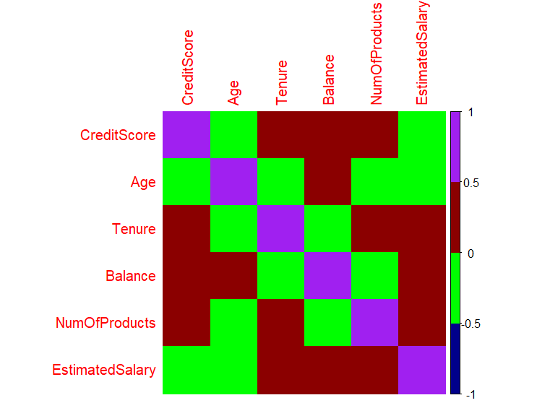
HEAT MAP ON CORRELATION BETWEEN VARIABLES

Slide 19
FINAL THOUGHTS
According to our Findings Females are more likely to churn
Tenure of six and seven month has high churning rate , this may be because of seasonal variations.
Germany is having high churning rate compared to France and Spain
Products are directly proportional to churning rate. Three and Four Products have high churning rate
Age between 40-50 are more likely to churn
Customers with credit score between 600-700 are more likely to churn
As From our Analysis Having card is not playing a crucial role because cards alone doesn’t have anY insight and cards along with gender doesn’t have any insight

Slide 20
THANK YOU
Jahnavi rambha
2nd year datasecience
Awdcrjy
Email- jahnavirambha@gmail.com

